Slide 1

Incident management and response Tool and tricks of the trade
Joakim Kävrestad Jönköping School of Engineering joakim.kavrestad@ju.se
© Crown Copyright, The National Cyber Security Centre 2023. This information is licensed under the Open Government Licence v3.0. To view this licence, visit https://www.nationalarchives.gov.uk/doc/open-government-licence/version/3/.
When you use this information under the Open Government Licence, you should include the following attribution: CyBOK Incident management and response Tool and tricks of the trade slides © Crown Copyright, The National Cyber Security Centre 2023, licensed under the Open Government Licence: https://www.nationalarchives.gov.uk/doc/open-government-licence/version/3/.

Slide 2
Literature note
This lecture is based on the following CyBOK knowledge areas:
Security Operations and Incident Management
Additional material is cited throughout the lecture

Slide 3
Agenda
Continuing the MAPE-K discussion
Monitor
Analyze
Plan
Execute
Technologies for the different steps

Slide 4
SOIM – MAPE-K

Slide 5
Monitor
Collection of information about the operation or hosts and networks
Includes data from sensor devices, other security devices, network equipment, and end-hosts
IDPS
Firewalls
Clients
Servers
…..

Slide 6
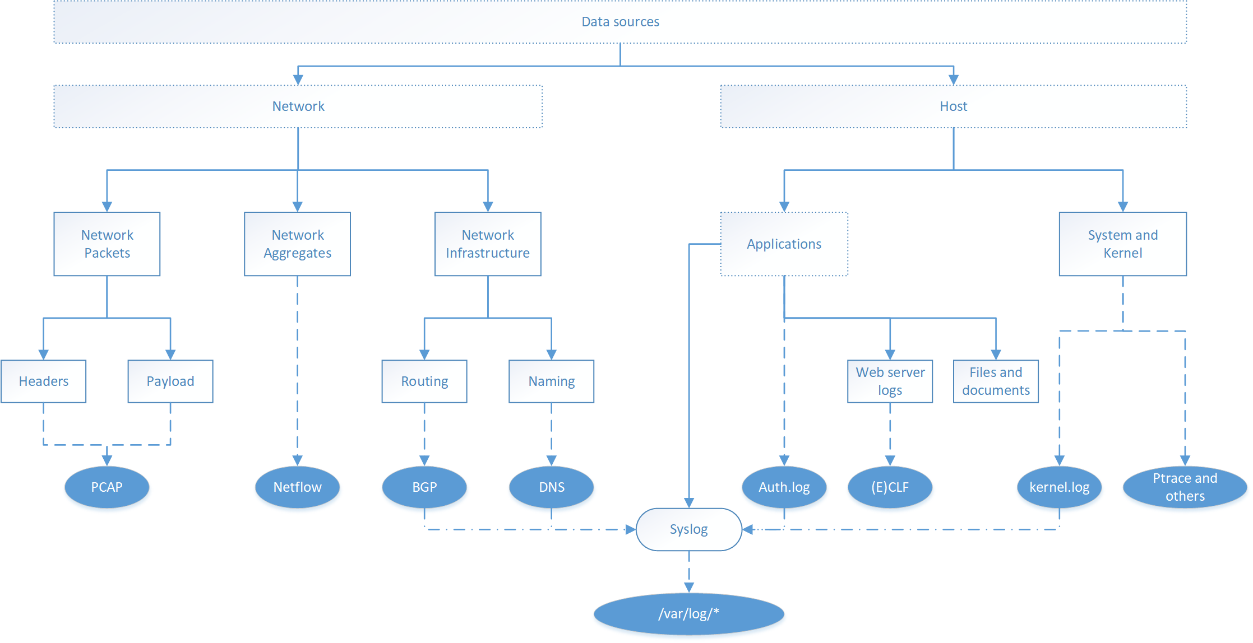
Monitor

Slide 7
Monitor - Snort
One of the most commonly used IDPS systems
Network-based IDPS
Open-source and maintained by the community and the Cisco Talos team

Slide 8
Monitor - Snort
Snort is a rule-based system
You define what is benign or harmful using rules
Alerts are sent when harmful data is identified
Different modes of operation
Sniffer: dumps packets in transit
Packet logger: Logs packets in transit (i.e. stores them to disk)
IDPS: blocks or permits traffic based on rules
PCAP investigation: Use rules to investigate PCAP files

Slide 9
Monitor – Snort rules
Snort is mainly configured from the file /etc/snort.conf
Rules are typically maintained in rule files which are included from the snort.conf
You can write your own rules or download rule-sets from Snorts web page
We will explore snort modes and rules in the labs

Slide 10
Monitor
Handling logs from all those sources can be challenging indeed
It is typical to have a system that aggregates log data from all different sources
SIEM (Security Information and Event Management), which focuses on security data
Dedicated log aggregation system such as syslog for other data
(Those can be the same tool)

Slide 11
REFLECT!
Use one minute to write down one-liners that describe what you just learned – come up with as many as you can.
Join up in pairs or groups and compare your lists for another minute.
Questions so far?

Slide 12
Analyze
All the data we collect needs to be analyzed
With all the data that we often gather, a stringent approach is needed to make sense of that data
This is where the SIEM comes into play
ELK/Elastic stack
Splunk
…..

Slide 13
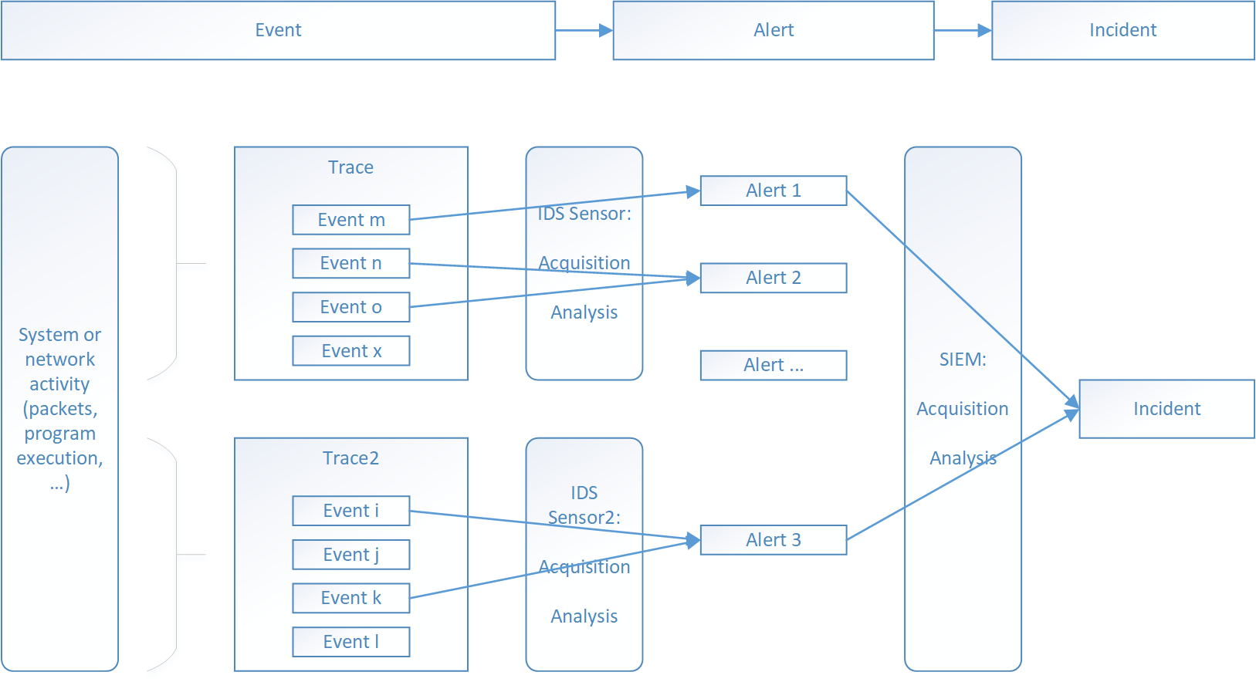
Analyze

Slide 14
Analyze – misuse detection
There are two broad methods for data analysis
Misuse detection
Anomaly detection
Misuse detection relies on definitions of harmful code/behavior/traffic…
Signatures
IoC

Slide 15
Analyze – misuse detection
From a technical perspective, a misuse detection tool will match the signature of bad, and report when a hit is found
Misuse detection is comparably cheap and easy to implement
A downside is difficulty in identifying new events

Slide 16
Analyze – Anomaly detection
Anomaly detection is essentially about finding deviations from normal system operations
Builds on the theory that an incident is an anomaly
Used in both SIEMs and IDPS systems

Slide 17
Analyze – Anomaly detection
Anomaly detection relies on models (often statistical) that define normal and anomalous behavior
Events will be given a score that reflect how normal they are
A threshold for when an alarm is raised must be decided upon

Slide 18
Analyze – Anomaly detection
Depending on the threshold, we will get more or less false positives or false negatives
False positive: Alert is raised for benign event
False negative: Alert is not raised for malicious event
True positive: Alert is raised for malicious even
True negative: Alert is not raised for benign event
Less false positives typically means less true positives

Slide 19
REFLECT!
Use one minute to write down one-liners that describe what you just learned – come up with as many as you can.
Join up in pairs or groups and compare your lists for another minute.
Questions so far?

Slide 20
Planning
The planning phase is, with the analyze phase, covered by the SIEM.
The SIEM aggregates information from the monitor and analyze phases
Connection
Correlation
Correlation with CTI
The ideal output is a list of incidents that an analyst needs to handle

Slide 21
Planning – ELK at a glance
The ELK stack (now Elastic stack) is a combination of four technologies
Elasticsearch
Logstash
Kibana
Beats
Logstash is a log aggregator which collects logs from various sources

Slide 22
Planning – ELK at a glance
Elasticsearch is a search engine
Kibana is a visualization layer for Elasticsearch which makes it possible to create various dashboards
Beats are agents that can collect data from hosts and forward to Elasticsearch
The components can be used as a SIEM

Slide 23
Planning – Splunk at a glance
SPLUNK is an enterprise set of tools capable of providing SIEM functionality
SPLUNK can process data from many different sources and provide aggregation and search functionality
The labs will go over both ELK and SPLUNK

Slide 24
REFLECT!
Use one minute to write down one-liners that describe what you just learned – come up with as many as you can.
Join up in pairs or groups and compare your lists for another minute.
Questions so far?

Slide 25
Execute
The response to detected incidents
Highly situational, different events require different responses
Can be partly automated but more complex incidents require human intervention

Slide 26
Execute - automated
To quite a large extent, mitigations are actually automated
IDPS block rules
Firewall filters
Malware quarantine
…..
When mitigations can't be automated, the Security Operations Center (SOC) takes over

Slide 27
Execute - SOC
NIST SP 800-53, Rev 5 describes a SOC as “the focal point for security operations and computer network defense for an organization”
Core task is to detect, analyze, and respond to incidents in a timely manner
Also includes preparation and handling of relevant tools for the task
A SOC can sometimes also handle security infrastructure

Slide 28
Execute – SOC roles
A SOC manager leads the SOC and typically reports to the CEO or CISO
Security engineers evaluate, implement, and maintain security technologies (tools)
Security analysts (incident responders) analyze threats and incidents (and alarms)
Threat hunters are tasked with finding threats and vulnerabilities before they are exploited by hackers

Slide 29
Execute - playbooks
Incidents are diverse, and it can be hard to always figure out the best course of action swiftly
Also, many incidents are quite frequently occurring
To help manage incidents efficiently, playbooks are used

Slide 30
Execute - playbooks
A playbook is basically a guide on how to handle a certain incident type
Playbooks can be developed as part of the incident response policy development
Should be refined after they are used
New playbooks defined upon the discovery of new incidents
General playbooks can be downloaded from the internet and adapted as needed

Slide 31
Execute - playbooks
The exact content of a playbook is of course up to the organization, but it typically includes
Roles to be involved in the handling of an incident
Staff roles
Technical roles (i.e. user accounts) and permissions
Tools to use
Steps to take
Some public examples from Microsoft
https://learn.microsoft.com/en-us/security/operations/incident-response-playbook-phishing

Slide 32
REFLECT!
Use one minute to write down one-liners that describe what you just learned – come up with as many as you can.
Join up in pairs or groups and compare your lists for another minute.
Questions so far?

Slide 33
Thank you for today!

